Slide 1
Face Recognition: A Convolutional Neural Network Approach
Instructor: Bhiksha Raj Student: T. Hoang Ngan Le

Slide 2
The Problem
Testing
Training
Recognition

Slide 3
Proposed System - Flowchart
Images
Identification
Image Sampling
Dimensionality Reduction
Convolutional Neural Network
Classification
Full Connected
Nearest Neighbor
Multi-layer Perceptron
SOM
KL transform

Slide 4
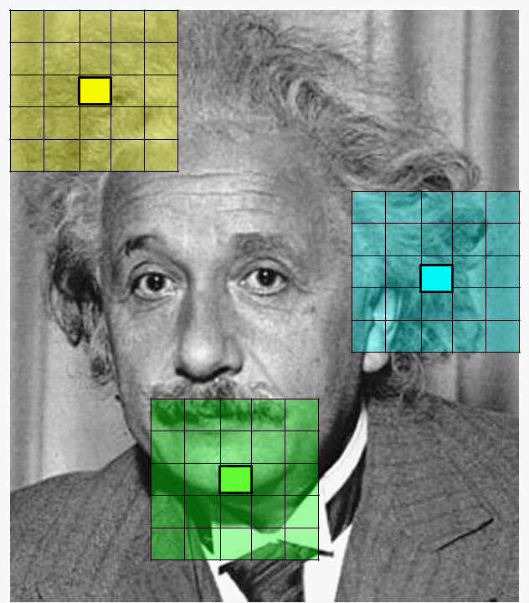
Image Sampling
…
A window is stepped over the image and a vector is created at each location.

Slide 5
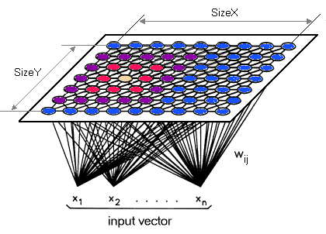
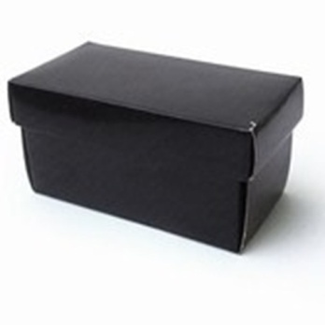
Dimensionality Reduction - SOM
SOM

Slide 6
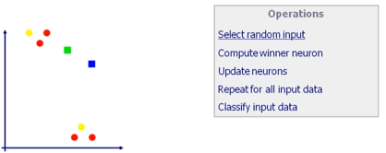
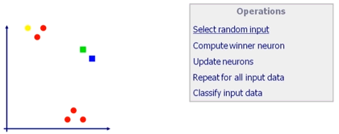
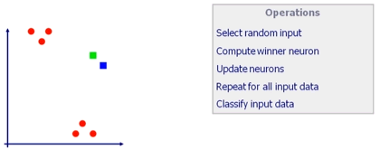
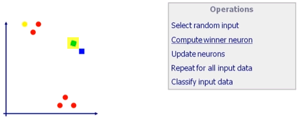
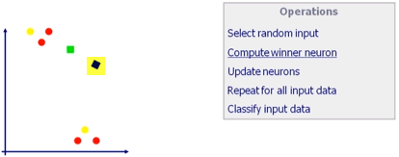
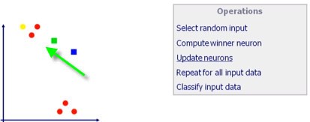
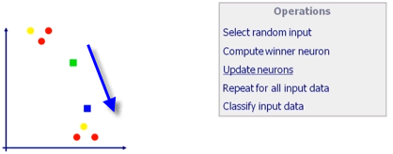
Dimensionality Reduction - SOM
1
4
2
5
3
6

Slide 7
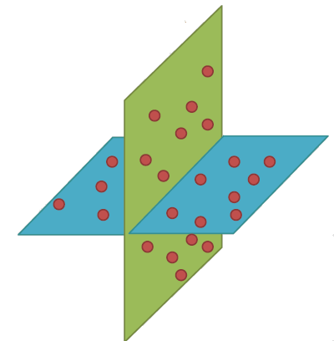
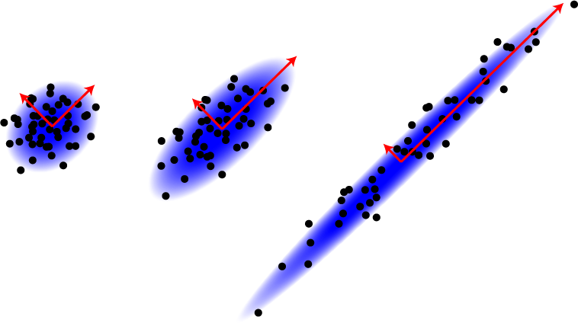
Dimensionality Reduction - KL Transform

Slide 8
Dimensionality Reduction - KL Transform
PCA
Objective function:
Karhunen-Loeve (KL) transform
Objective function:

Slide 9
Convolutional Network

Slide 10
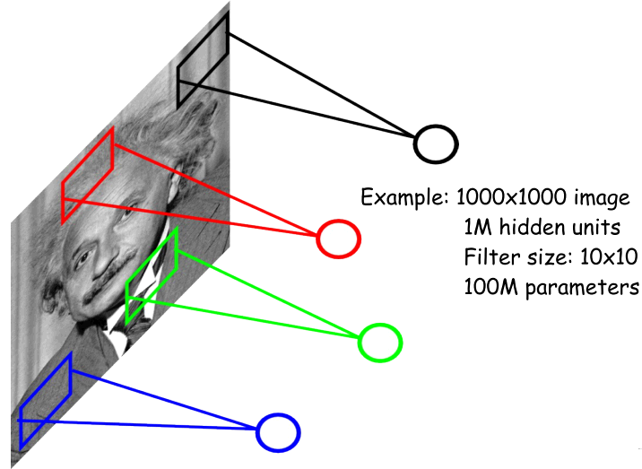
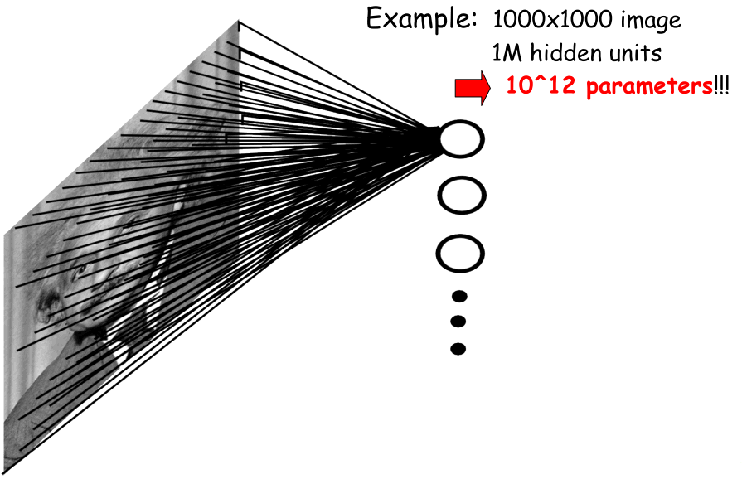
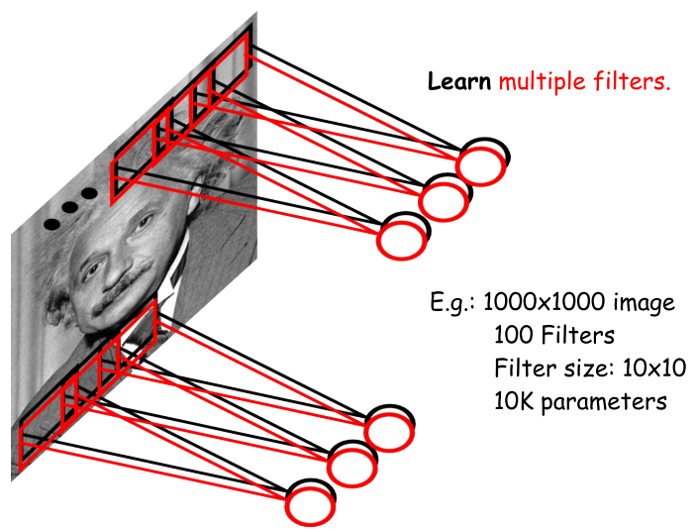
Convolutional Network
Motivation

Slide 11
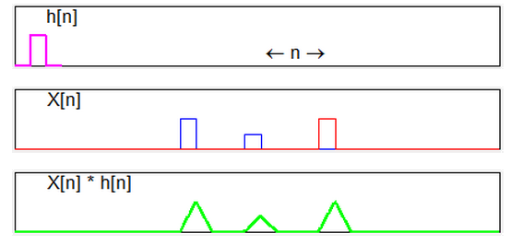
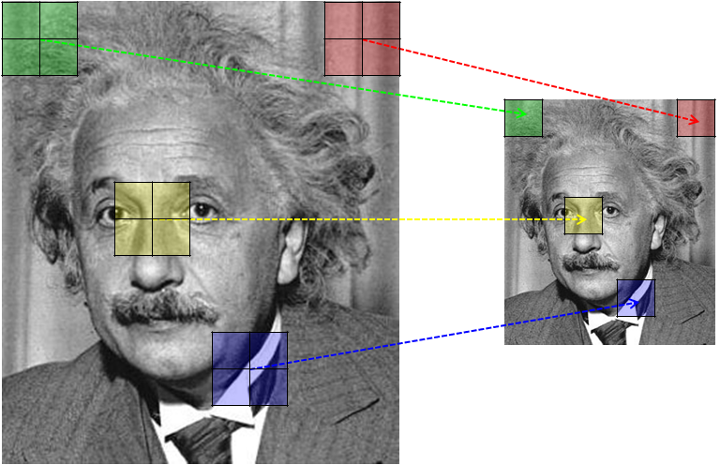
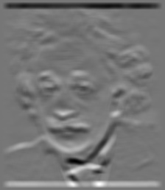
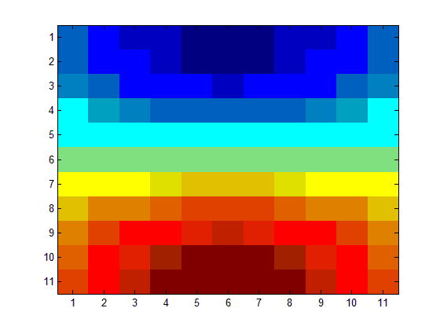
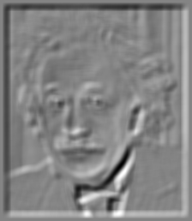
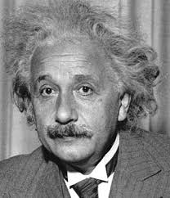
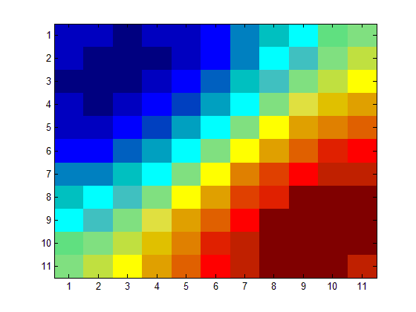
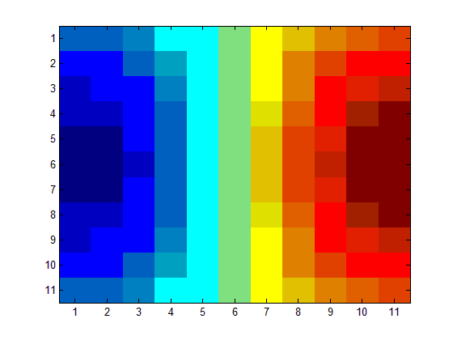
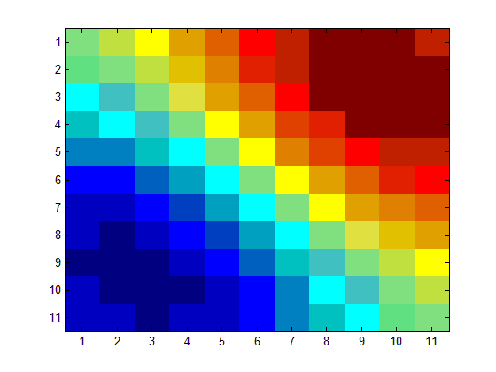
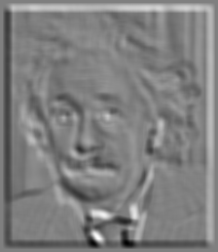
Convolutional Network
Convolution
Subsample
1D
local averaging operator
2D

Slide 12
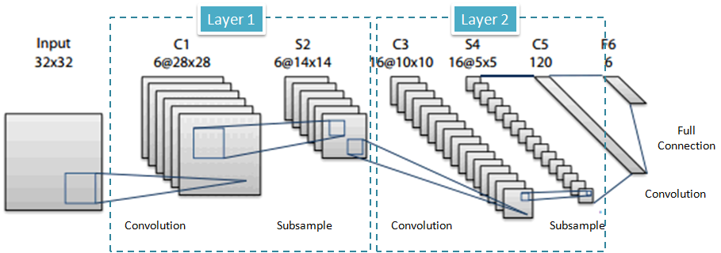
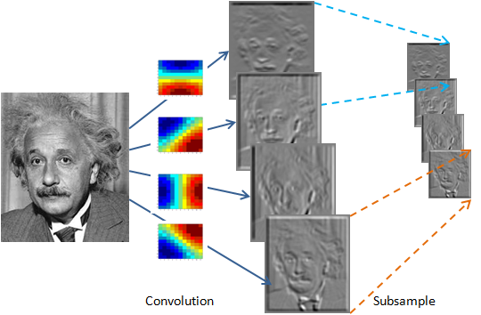
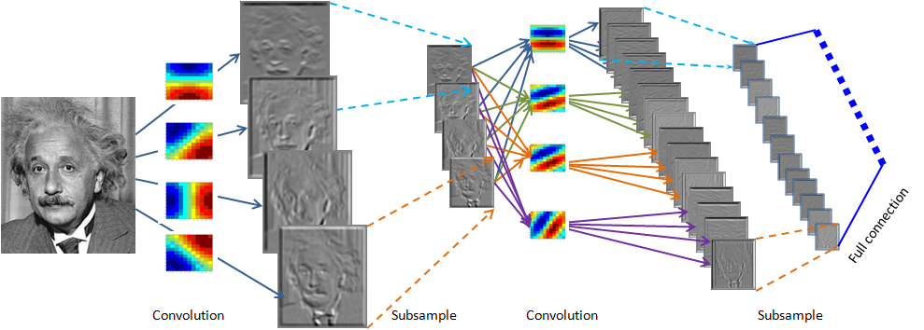
Convolutional Network
Layer 1
Layer 2

Slide 13
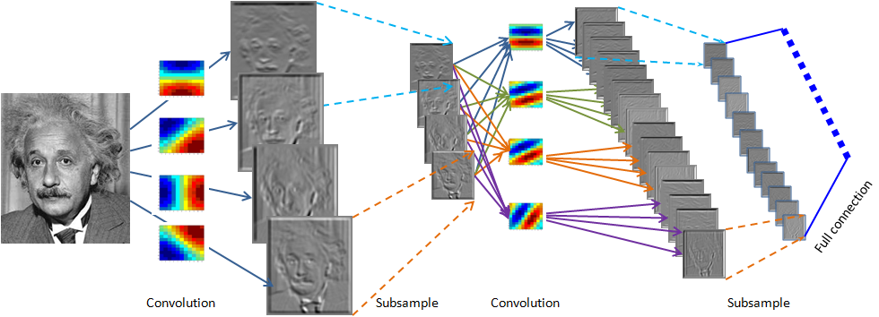
Convolutional Network
w₁₁
w₁₂
w₁₃
Backpropagation gradient-descent procedure
w₂₁
w₂₂
w₂₃
Backpropagationalgorithm for standard MLP
w₃₁
w₃₂
w₃₃

Slide 14
Convolutional Neural Network - System
Convolution Neural Network
MLP Style Classifier
Dimensionality Reduction
SOM
Feature Extraction
Nearest – Neighbor Classifier
Classification
Image Sampling
Images
K-L Transform
Multi-Layer Perceptron

Slide 15
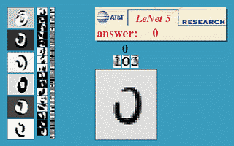
Convolutional Neural Network – Extensions
LeNet-5
http://yann.lecun.com/exdb/lenet/
C1,C3,C5 : Convolutional layer.
5 × 5 Convolution matrix.
S2 , S4 : Subsampling layer.
Subsampling by factor 2.
F6 : Fully connected layer.
About 187,000 connection.
About 14,000 trainable weight

Slide 16
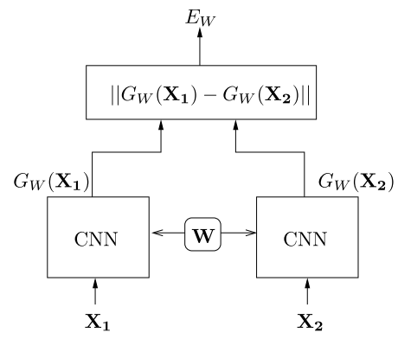
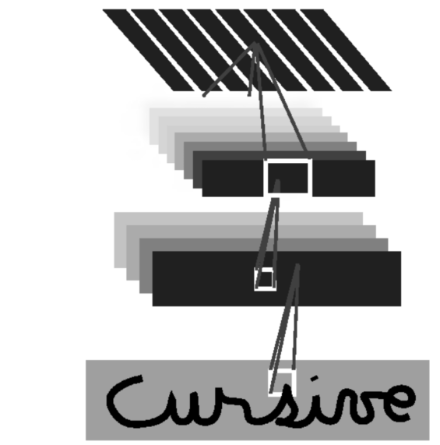
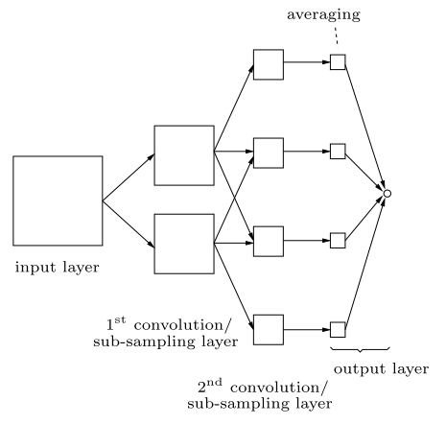
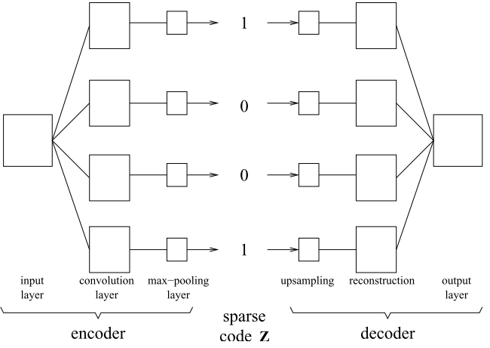
Convolutional Neural Network – Extension and variants
Space Displacement Neural Networks (SDNN)
Siamese CNNs
Shunting Inhibitory Convolutional Neural Networks (SICoNNet)
Sparse Convolutional Neural Networks (Sparse CNN)

Slide 17
Convolutional Neural Network – Experiment & Comparison
200 training images and 200 test images from ORL database (AT&T).
Various Experiments
Variation of the number of output classes
Variation of the dimensionality of the SOM
Variation of the quantization level of the SOM
Variation of the image sample extraction algorithm
Substituting the SOM with the KL transform
Replacing the CN with an MLP
…

Slide 18
Comments
Convolutional Neural Networks are a special kind of multi-layer neural networks.
Like almost every other neural networks they are trained with a version of the back-propagation algorithm.
Convolutional Neural Networks are designed to recognize visual patterns directly from pixel images with minimal preprocessing.
Shared weights: all neurons in a feature share the same weights.
In this way all neurons detect the same feature at different positions.
Reduce the number of free parameters in the input image.

